Slide 1


Capstone Project Phase I
REVIEW I
PROJECT TITLE
Domain
TEAM MEMBERS :
Supervisor Name
INDUSTRY NAME
KPR Institute of Engineering and Technology, Coimbatore, Tamil Nadu, India
1

Slide 2
CONTENT
KPR Institute of Engineering and Technology, Coimbatore, Tamil Nadu, India
2

Slide 3
ABSTRACT
Adjusts street light brightness based on vehicle presence,reducing unnecessary energy consumption.
Uses sensors to turn on lights automatically when ambient light levels drop, ensuring consistent road visibility.
Identifies and reports faulty lights for timely maintenance, improving system reliability.
Tracks the number of passing vehicles using IR sensors for traffic analysis.
Employs NRF2401 modules for efficient data transmission between Arduino-based transmitters and ESP8266 receivers
KPR Institute of Engineering and Technology, Coimbatore, Tamil Nadu, India
3

Slide 4
INTRODUCTION
Smart street lighting systems leverage advanced sensors and communication technology to enhance safety and visibility on roadways at night.
These systems significantly reduce energy consumption by dynamically adjusting brightness based on vehicle movement, leading to cost savings for municipalities.
By automating monitoring and control, smart systems improve response times to faults and maintenance needs, increasing overall operational efficiency.
Smart street lighting provides better control and accuracy compared to traditional methods, ensuring that lighting meets the specific requirements of the environment.
KPR Institute of Engineering and Technology, Coimbatore, Tamil Nadu, India
4

Slide 5
LITERATURE REVIEW
(4 -6 slides)
KPR Institute of Engineering and Technology, Coimbatore, Tamil Nadu, India
5

Slide 6
PROBLEM IDENTIFICATION
Street lights stay fully lit all night, causing unnecessary electricity consumption.
Detecting and fixing faulty street lights relies on manual inspection, leading to delays in maintenance.
Conventional systems do not provide instant data tracking, limiting the ability to adjust lighting based on traffic flow.
Current street lighting setups lack features for counting vehicles or monitoring traffic patterns.
Lights operate at a constant level without adapting to changes in road activity, resulting in continuous energy use.
KPR Institute of Engineering and Technology, Coimbatore, Tamil Nadu, India
6

Slide 7
METHODOLOGY
Uses sensors to identify faulty street lights and wirelessly report issues to the control center.
Adjusts light brightness based on vehicle presence, detected through IR sensors, to save energy.
Activates lights and enhances brightness when motion is detected, improving visibility for vehicles and pedestrians.
Tracks the number of passing vehicles for traffic analysis and urban planning.
Utilizes NRF2401 modules to transmit data on faults and maintenance from Arduino to ESP8266, which sends it to a local server for monitoring.
7
KPR Institute of Engineering and Technology, Coimbatore, Tamil Nadu, India

Slide 8
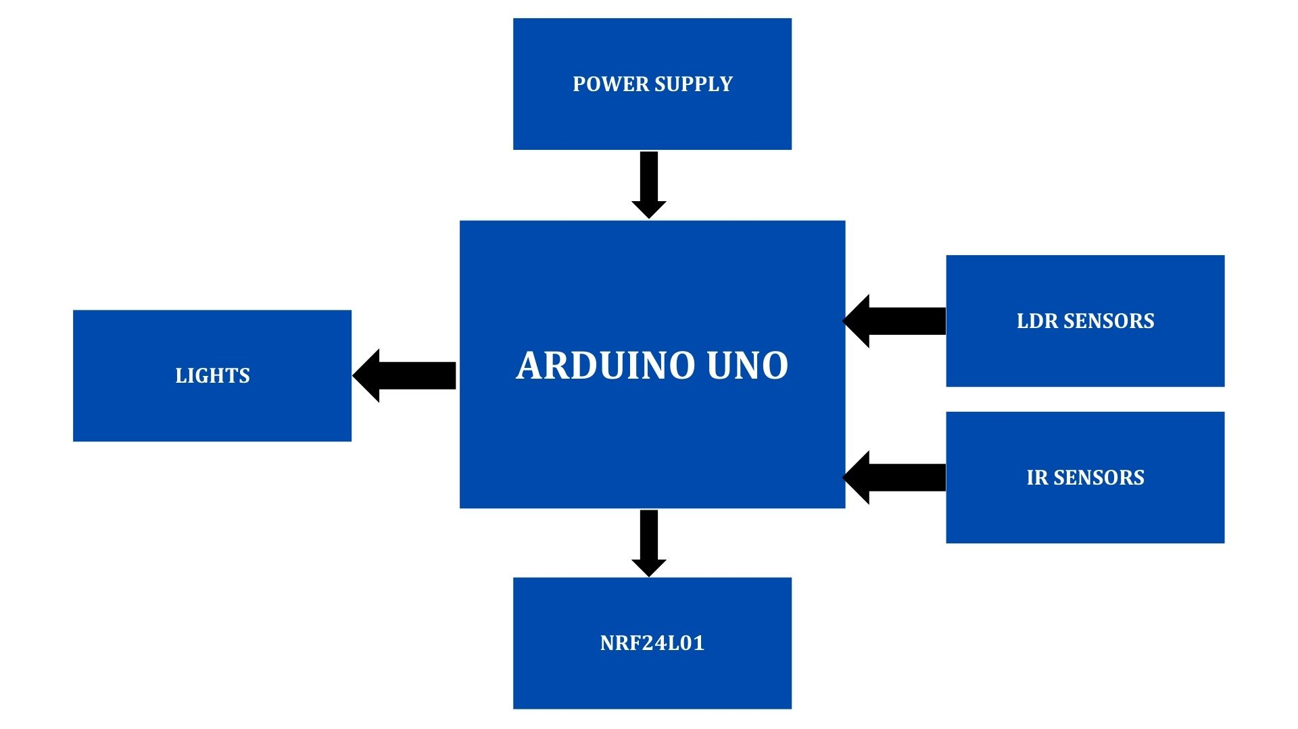
BLOCK DIAGRAM FOR TX
8
KPR Institute of Engineering and Technology, Coimbatore, Tamil Nadu, India

Slide 9
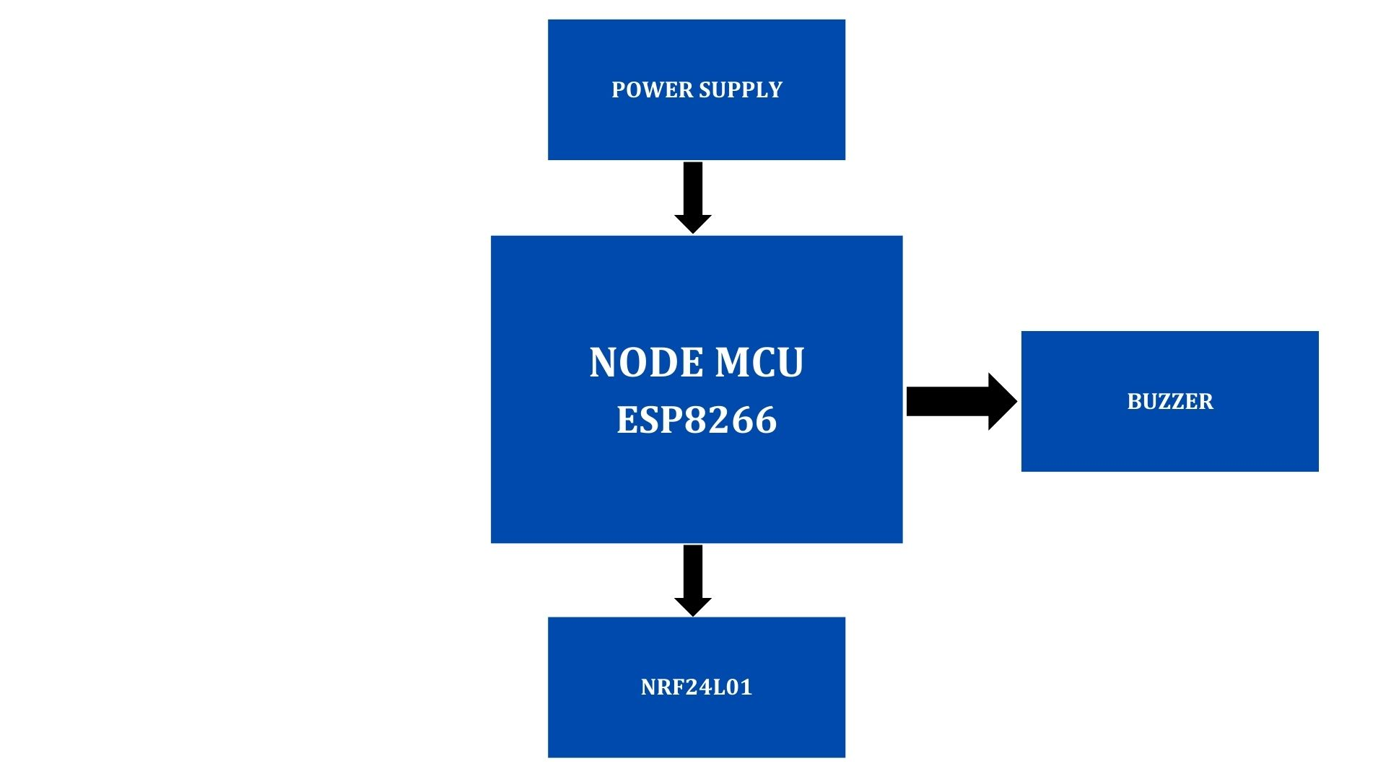
BLOCK DIAGRAM FOR RX
8
KPR Institute of Engineering and Technology, Coimbatore, Tamil Nadu, India

Slide 10
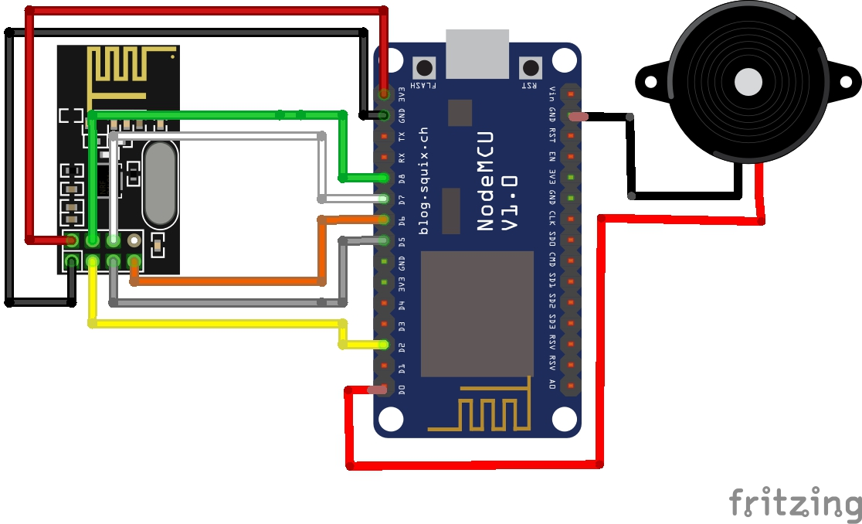
CIRCUIT DIAGRAM RX
9
KPR Institute of Engineering and Technology, Coimbatore, Tamil Nadu, India

Slide 11
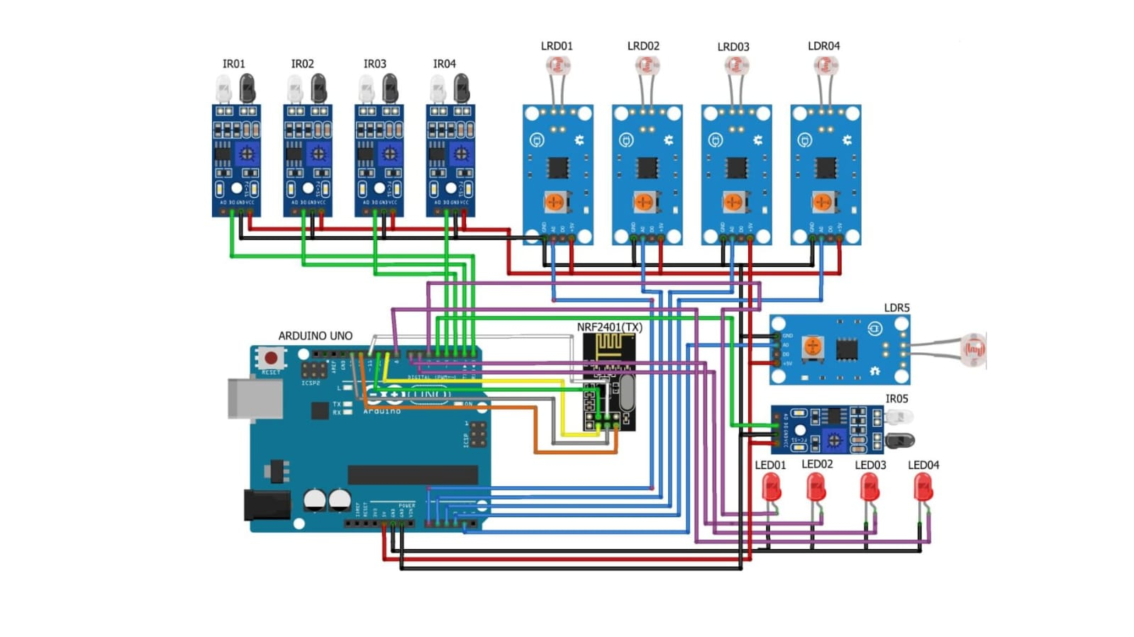
CIRCUIT DIAGRAM RX
9
KPR Institute of Engineering and Technology, Coimbatore, Tamil Nadu, India

Slide 12
SIMULATION / EXPERIMENTAL SETUP
10
KPR Institute of Engineering and Technology, Coimbatore, Tamil Nadu, India

Slide 13
RESULTS AND DISCUSSION
The implementation of the Vehicle Movement-Based Smart Street Light System resulted in a significant improvement in energy efficiency by dimming lights when no vehicles are present, leading to considerable electricity savings.
Enhanced fault management with quick detection and reporting reduced maintenance downtime.
Scalable design allows easy expansion and integration of additional features, making it adaptable for larger areas.
11
KPR Institute of Engineering and Technology, Coimbatore, Tamil Nadu, India

Slide 14
REFERENCES
12
KPR Institute of Engineering and Technology, Coimbatore, Tamil Nadu, India

Slide 15
KPR Institute of Engineering and Technology, Coimbatore, Tamil Nadu, India
12

